Slide 1
Dr. Delaunay or: How I Learned to Stop Worrying and Love the Triangulations
Saip-Can Hasbay (01428723)
Supervisor: David Hahn
Research Unit of Computer Graphics
Institute of Visual Computing & Human-Centered Technology
TU Wien, Austria
Notes:
Hello everybody.
My name is Can.
Today I am going to talk about triangulations or tetrahedralizations.
Better said: Dr. Delaunay or: How I Learned to Stop Worrying and Love the bomb.
Oops sorry, I meant triangulations.
Maybe before we begin, since it is an early start, we can take it a bit easy.
Any Stanley Kubrick fans raise your hands.
Cool!
In any case, if you don't know him, he was a great film director and he has a film from 1964 called Dr. Strangelove or: How I Learned to Stop Worrying and Love the Bomb.
So if you haven't watched it, I would definitely recommend it.
Though it would have been great, unfortunately, we can't talk about the film.
But as an idea, me talking about geometry is almost as funny as the film itself, mainly due to my inability to comprehend things mathematically.
But anyways, let's begin.

Slide 2
Outline
Delaunay Triangulations
Background and Motivation for Tetrahedralizations
TetWild – Tetrahedral Meshing in the Wild, Yixin Hu et al. 2018
Conclusion
Notes:
Here is the overview of the presentation.I will quickly introduce Delaunay triangulation in 2D.
Then, we will have an extensive motivational part for tetrahedralizations.
Next, we will talk about two important papers about tetrahedralizations.

Slide 3
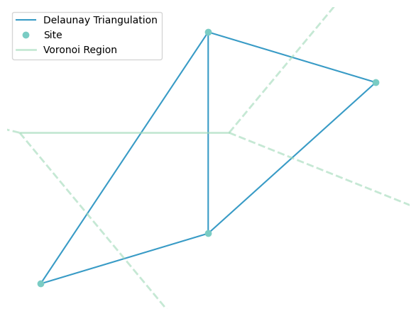
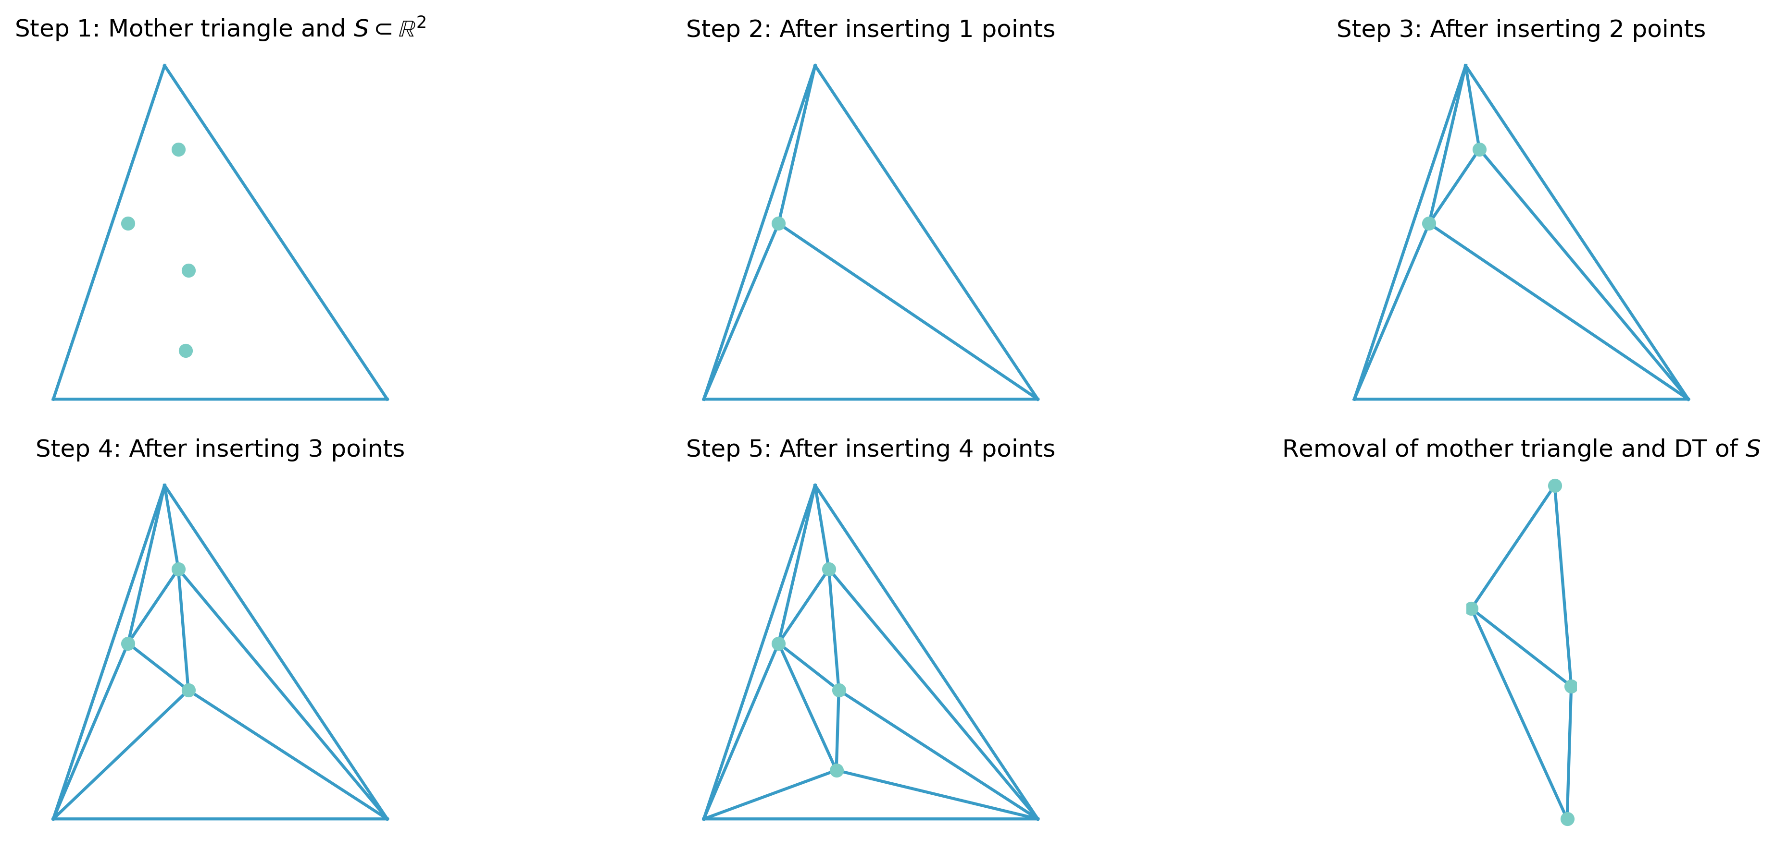
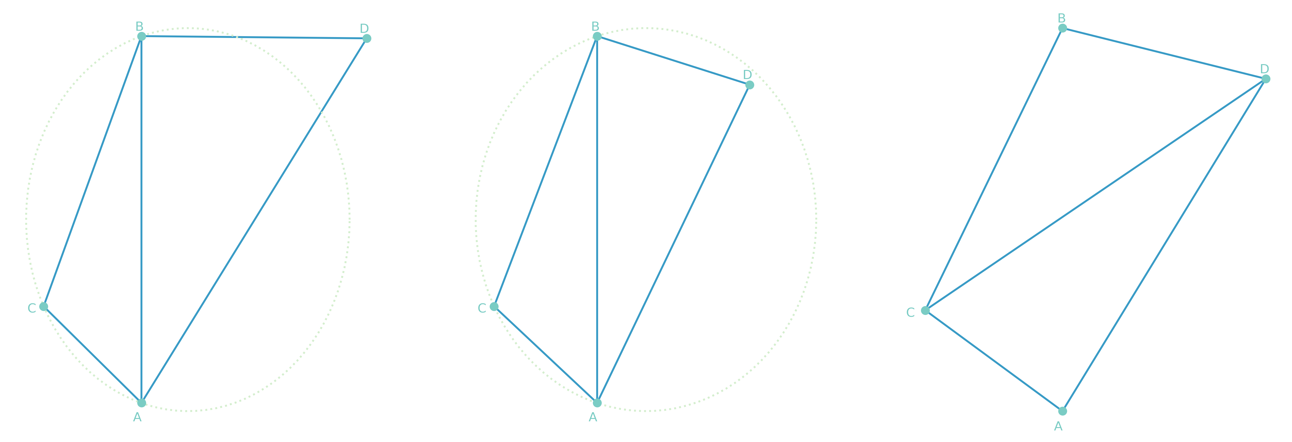
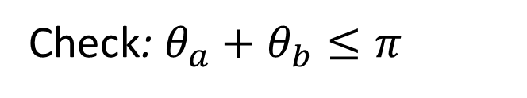
Delaunay Triangulations (DT) in 2D
Check: $θ_{a}+θ_{b}≤π$
ab is locally Delaunay.
ab is not locally Delaunay.
An edge flip makes it locally Delaunay.
Notes:
Let's give a quick introduction to Delaunay Triangulations in 2D.
Here we see an example of a Delaunay triangulation and its dual Voronoi diagram.
The collection of blue edges is the DT and light green refers to the Voronoi diagram.
The points you see in green are the sites of the Voronoi Regions.
Connecting three sites by straight edges we get a triangle in DT.
However, there is a requirement for a triangle to be Delaunay.
Empty circumcircles characterize Delaunay triangles.
A triangle abc is Delaunay iff the circumcircle is empty of any site of the input set.
Here on the left, we see a valid Delaunay triangle as d is outside the circumcircle of abc.
We call ab locally Delaunay if an empty circle passes through a and b.
In the middle, we see that ab is not locally Delaunay.
The cool thing is that given a non-DT, we can convert it into Delaunay by flipping non-locally Delaunay edges to locally Delaunay edges.
One property that helped me to understand it more easily was to check the opposite angles of the shared edge.
So, if the sum of the opposite angles theta A and theta B is smaller than or equal to pi, then the edge is locally Delaunay.
This is great because given a triangulation if every edge is locally Delaunay, the triangulation is the DT.
Ok, lastly let's show a quick example.
Here we show an incremental approach to obtain DT.
We see our input points in green.
In the first step, we wrap these points with the so-called mother triangle.
Then, we start to add the points from the input set.
We check if edges are locally Delaunay and if not we perform edge flips.
We do this for all the points and finally remove the mother triangle.
The result is the DT of the input set.
So, this is it.
We give a more thorough and visual introduction to DTs in the report.
So, if you are interested, you can check our report which in the end I will provide a QR code.

Slide 4
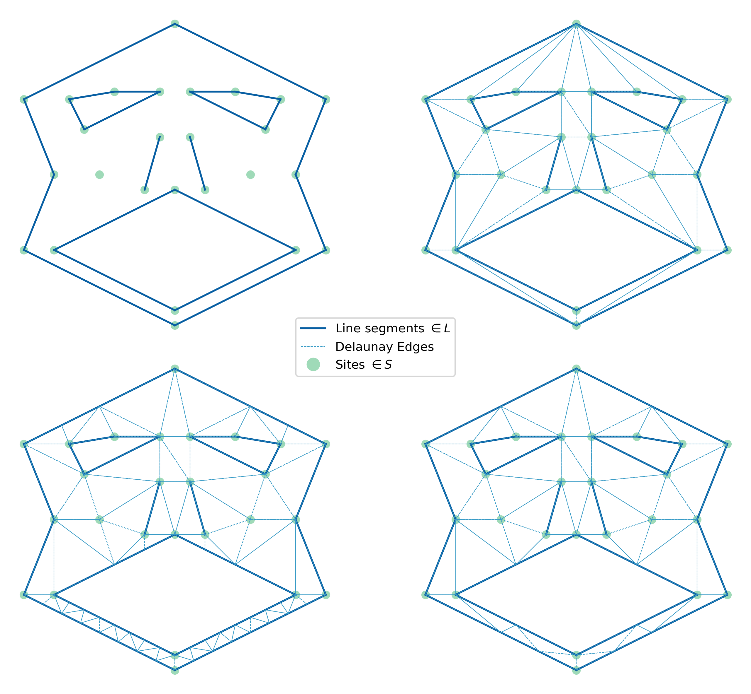

Constrained or Conforming DT in 2D
Input
Constrained DT
Points
Line segments
Conforming DT
Constrained conforming DT
Notes:
In constrained triangulations, the input not only consists of a set of points, but also a set of line segments L.
The input is triangulated as before, but we ensure all line segments are contained as edges in the triangulation.
A constrained triangulation can be constructed by connecting the sites of S by a straight edge, iff the edge does not intersect a
line segment from L.
A constrained DT is not truly a DT.
Not all resulting triangles are Delaunay triangles.
But, it avoids small angles as much as possible.
In some sense, it is the closest to a DT.
Similar to constrained DT, the input of a conforming DT are sites S, and line segments L.
However, a conforming DT is truly a DT (i.e., all triangles are Delaunay).
To truly become DT, a conforming DT may subdivide its edges.
This subdivision is done by inserting new points, called Steiner points.
Constrained conforming DT is a hybrid approach of constrained and conforming DTs (J. R. Shewchuk, 1996a, 1996b).
They also use Steiner points for the triangulation (Fig. 9).
However, unlike conforming DTs, they are not truly Delaunay.
Constrained conforming DTs use fewer Steiner points than conforming DTs, which makes them more preferable in practice.

Slide 5
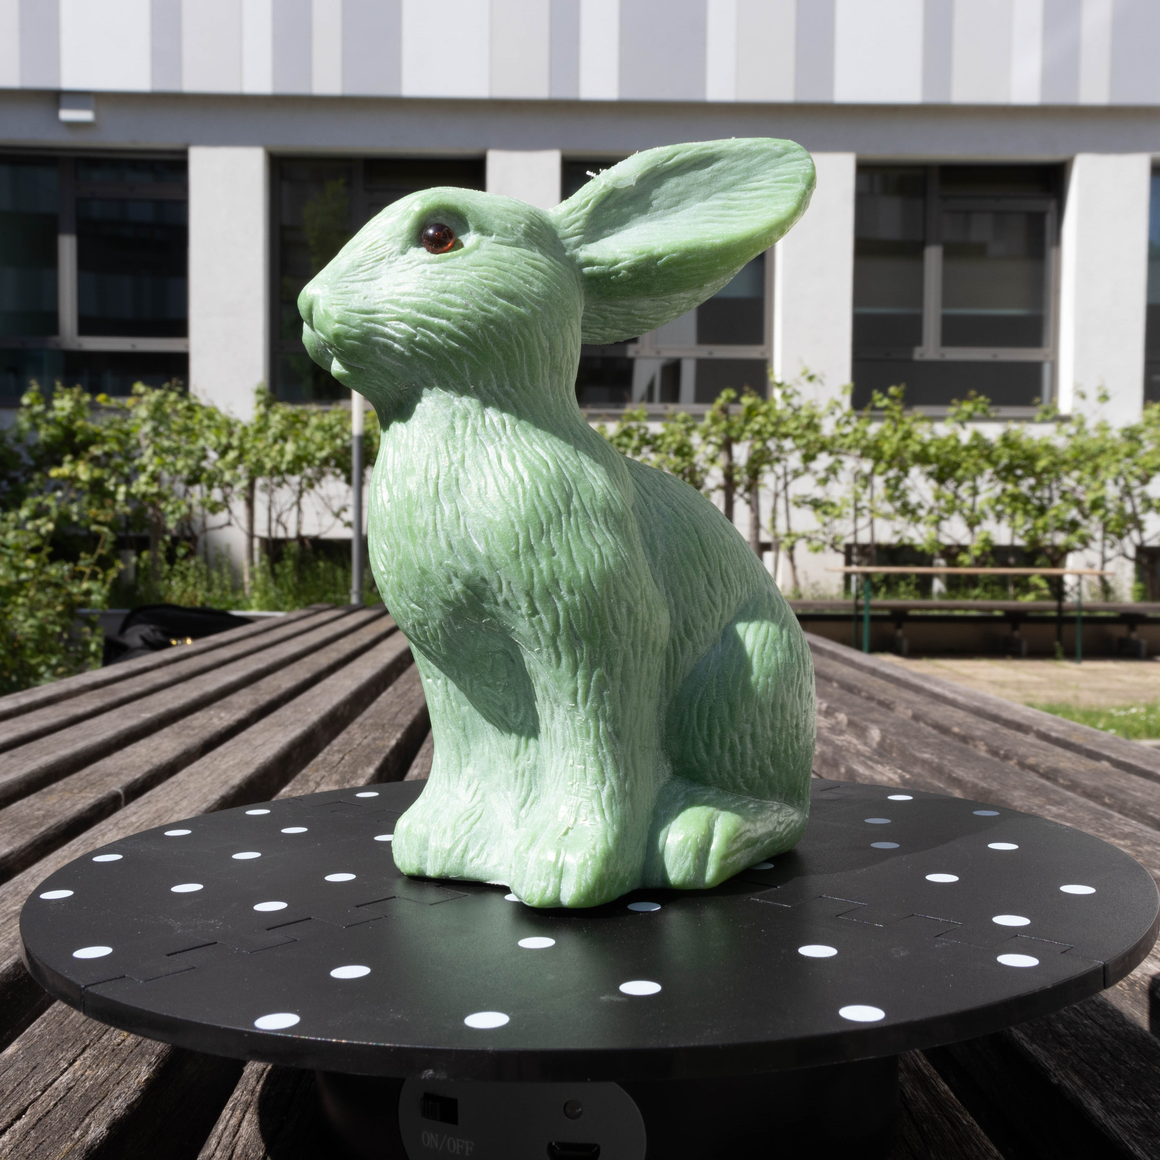
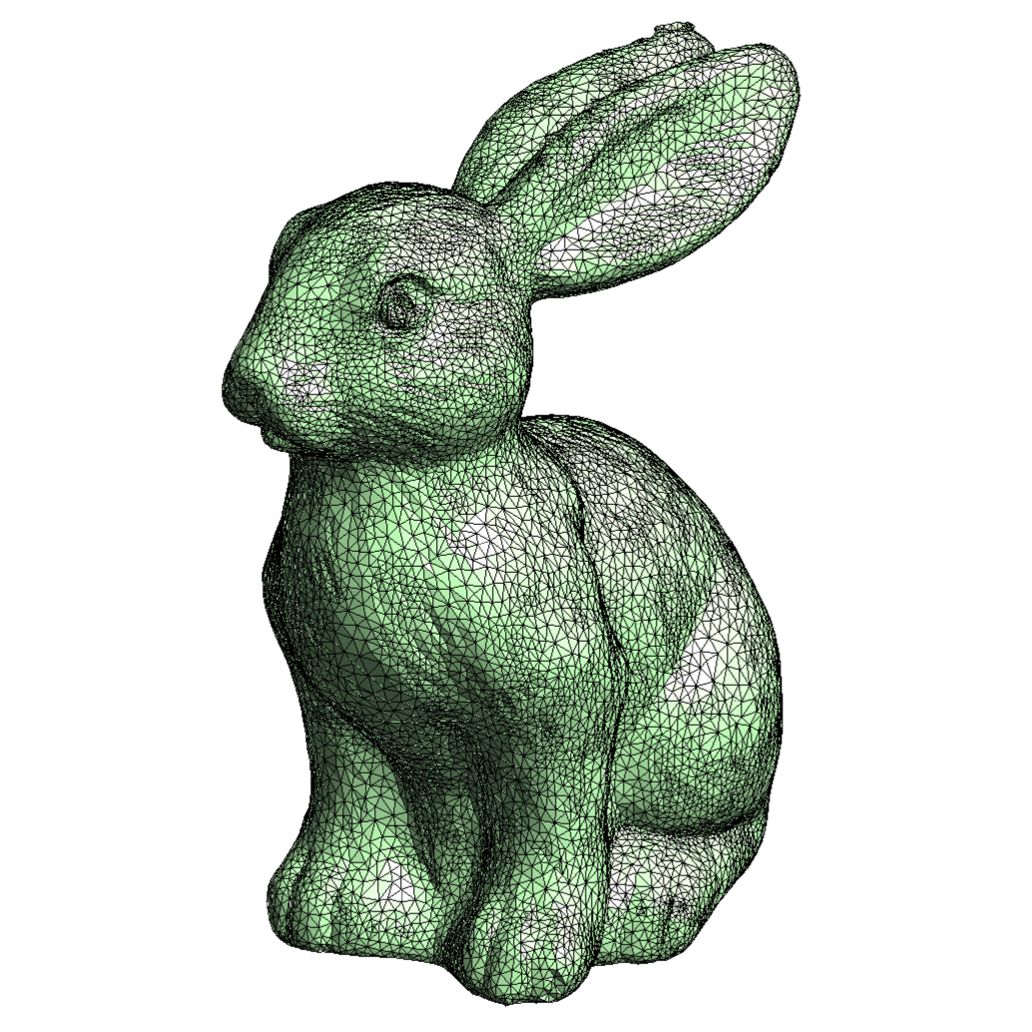
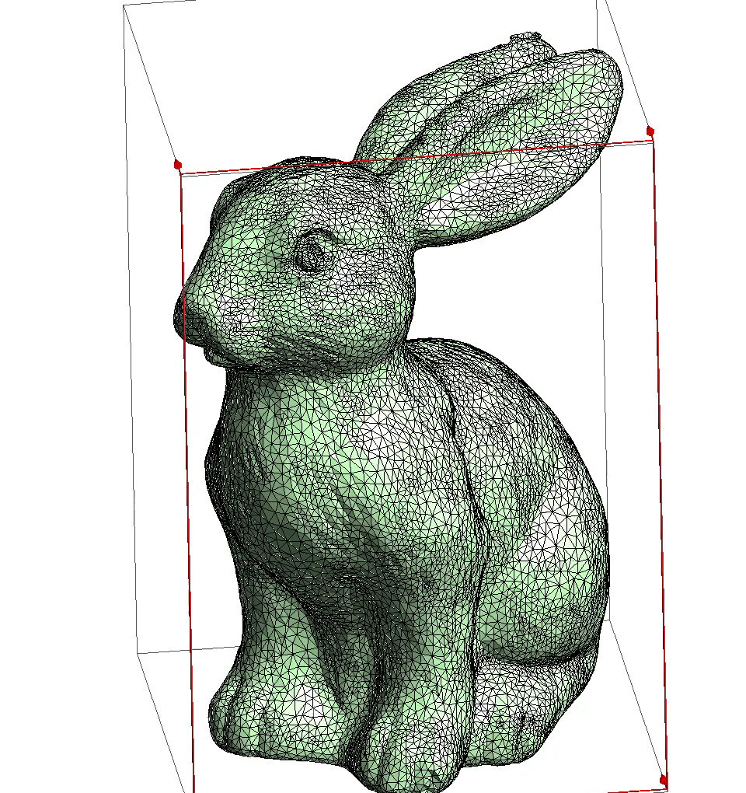
What is a tetrahedralization?
A bunny found in the wild
Surface Representation
Volumetric Representation
Notes:
It is a volumetric discretization method.
Input: usually takes 3D shape
Uses tetrahedra to fill the shapes interior
Output: volumetric tetrahedral mesh that conforms to the input surface.

Slide 6
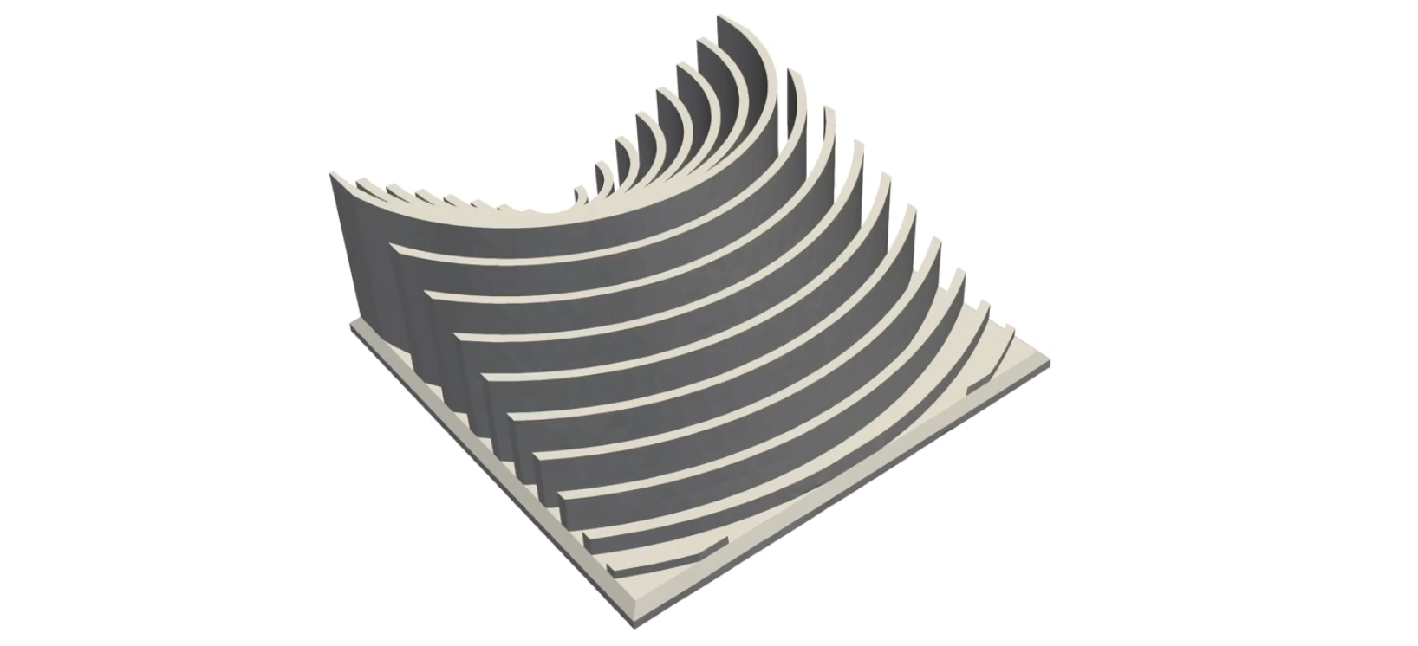
But… Why?
Taken from Fast tetrahedral meshing in the wild
Hu et al. 2020, SIGGRAPH 2020
Notes:
Has a lot of applications. E.g., physical simulation, rendering, interpolation

Slide 7
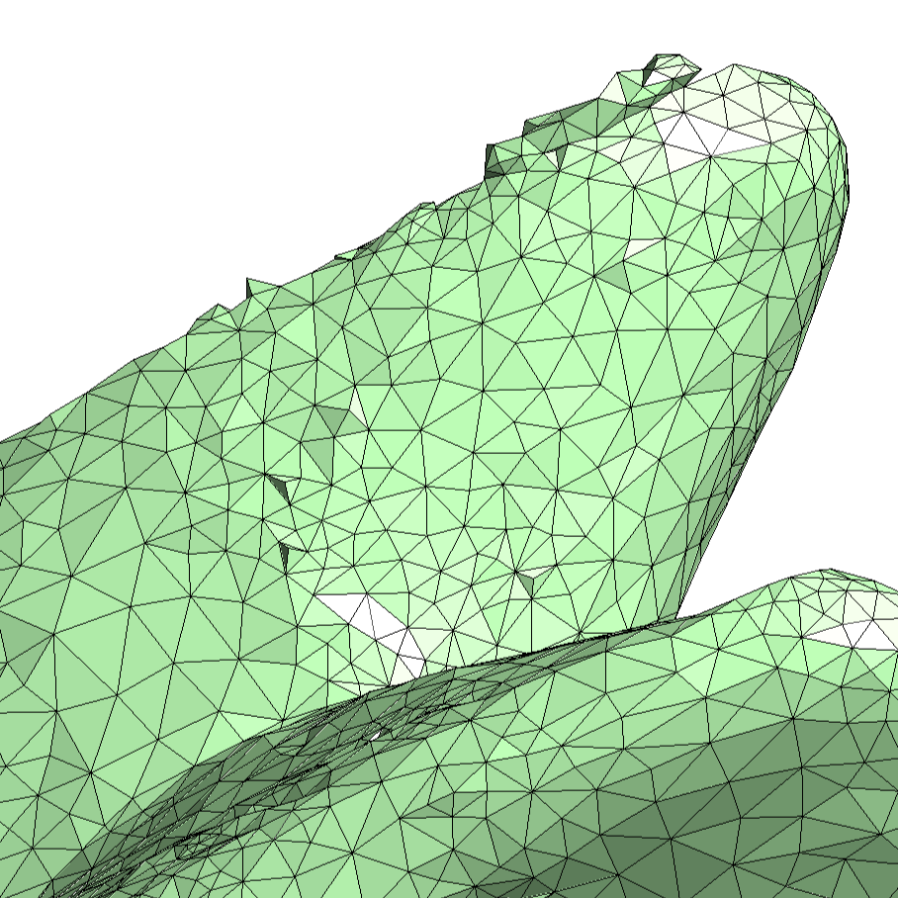
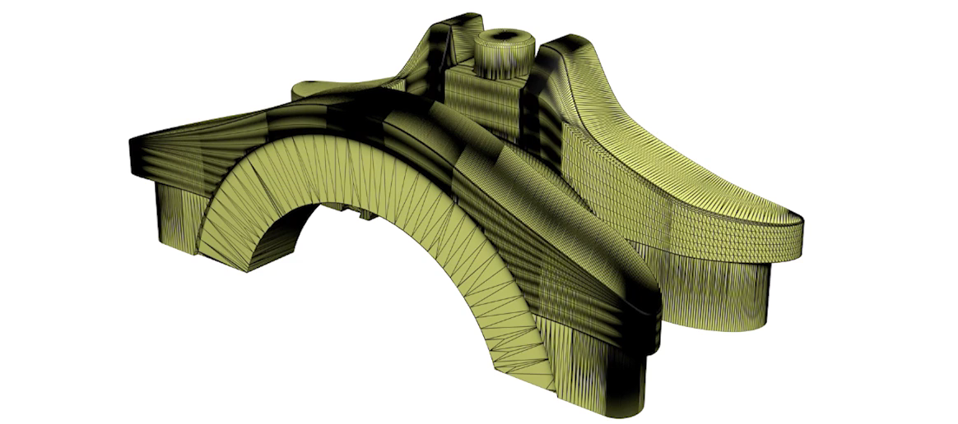
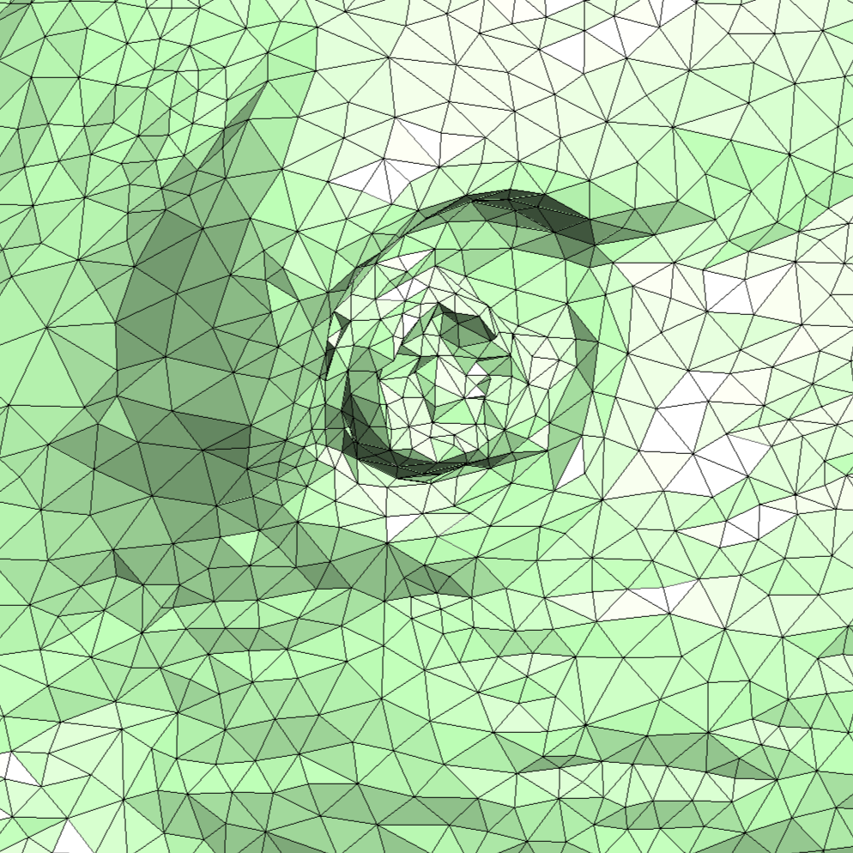
Difficulties
TetWild Hu et al. 2018, SIGGRAPH 2018
Notes:
Overall, this is a hard problem.
A lot of work has been done already.
1. Input mesh that might be obtained from real world can be far from what the algorithm expects.
- self intersections
- small gaps
So there is no robust and automatic way to clean up the surface. Requires manual intervention.
Fig. Contains dense needle like triangles.
When you zoom in: strange regions
- self-intersections
- it is just garbage: or triangle soup
There are a bunch of models like this in the wild.
Interesting dataset: Thingi10k. Contains real world surface meshes.
Hu mentions they are ideal for 3d printing, but they are horrible as surface mesh.
When they initially tried to tetrahedralize them, they encountered a problem.
There was no method to robustly tetmesh all of them.
Led to crashes, or outputted something completely different from the input.

Slide 8
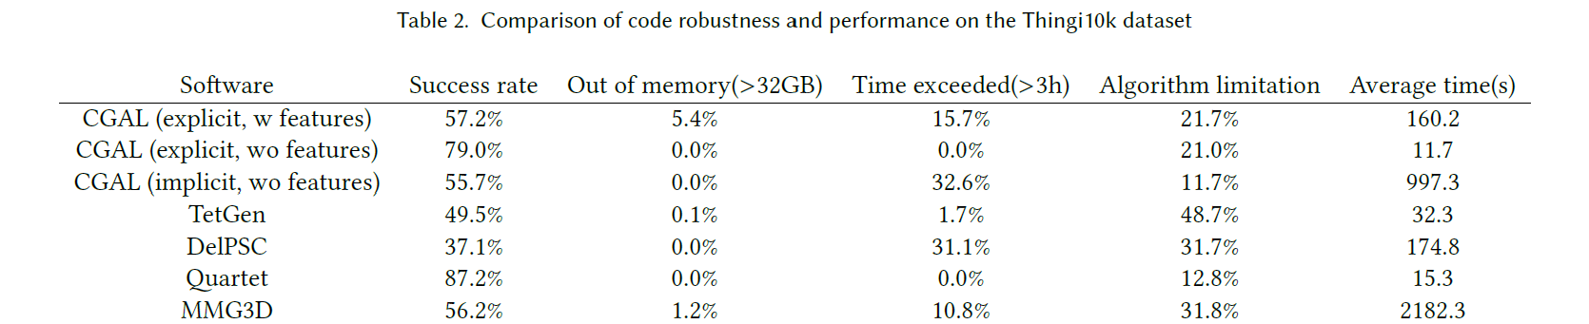
Is there a robust method?
TetWild Hu et al. 2018, SIGGRAPH 2018
Notes:
Is it possible to have a method to robustly tetrahedralize a mesh while preserve the input surface as much as possible?
For example Cgal, tetgen, DelPSC, Quartet and MMG3d.
Results are not bad as they are not designed strictly for this purpose.
Quartet has high success rate, but some of the results lose feautres -> not what we desire.
Also 87.5 is not good enough.
Basically, there are methods that are robust like quartet but are not faithful to the input mesh and vice versa.
There are mathematical proofs of robustness of existing methods.
But they are in infinite precision, when they are implemented in floating points, they can fail due to numerical issues.

Slide 9
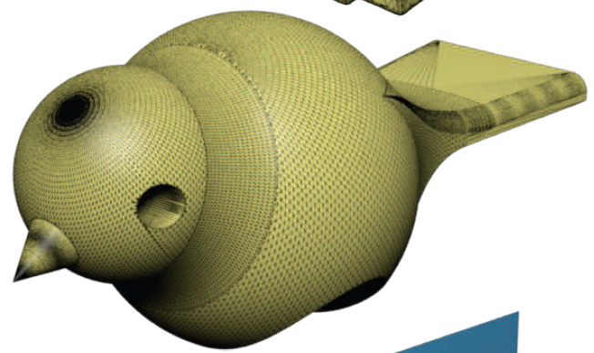
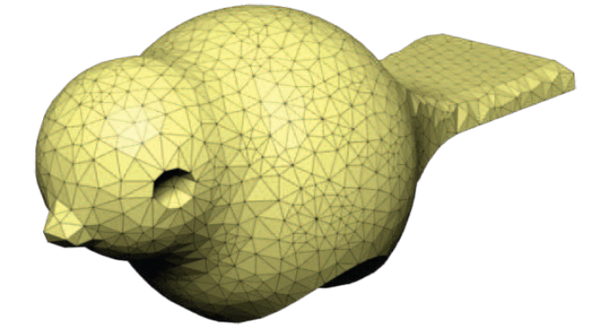
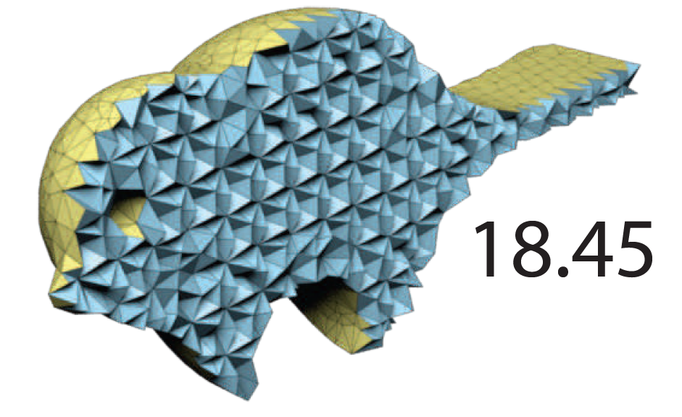
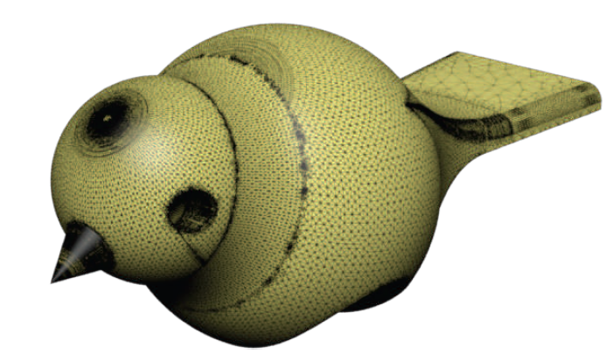
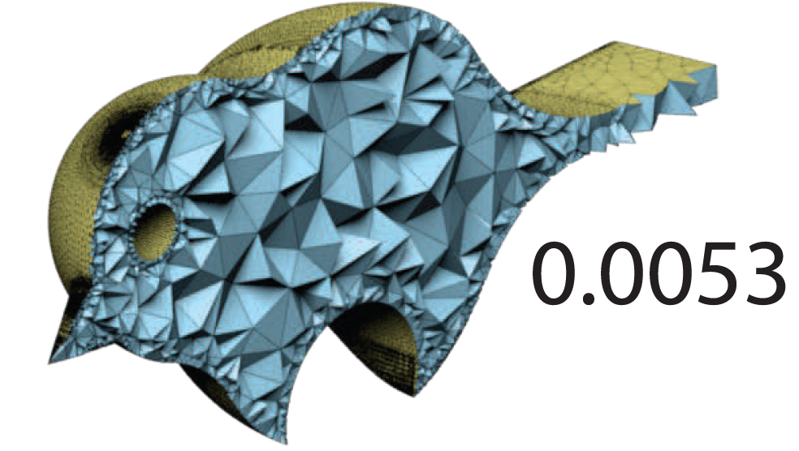
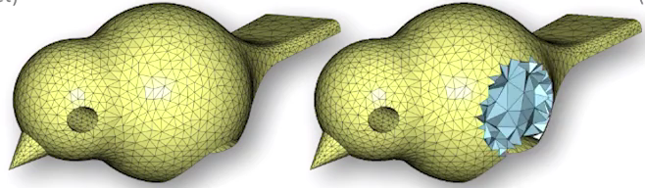
TetWild, Hu et al. 2018
Input
Robustness
Faithfulness
Generated by
Quartet
Generated by
Tetgen
Generated by
TetWild

Slide 10
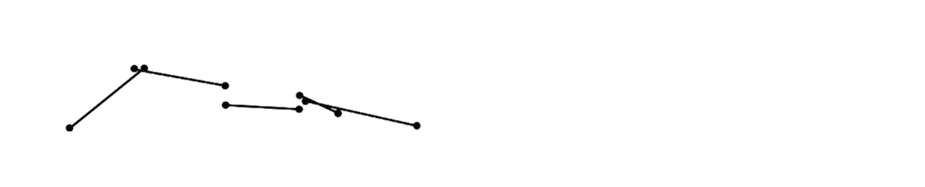
TetWild: Hu et al. 2018
Method
Closed under rationals
Approximate input surface within an envelope.
Why envelope?
Notes:
Hu proposes a new method which is:
1. closed under rationals.
2. approximate input surface within an envelope (controlled by a parameter, envelope size)
Why envelope?
If input contains smalls gaps or tiny creases, as long as they stay inside an envelope, they can all be resolved in the output.

Slide 11
TetWild: Input & Output
Input: Triangle mesh
No assumption about the input.
Output: Approximately constrained tetrahedral mesh.
Manages to deal with imperfect regions.
Notes:
Input: a triangle soup that forms the surface of a 3d shape.
- No assumption about the input.
Out: approx. constrained tetrahedral mesh within an envelope.
- method is able to cleanup imperfect regions and produce high quality out.

Slide 12
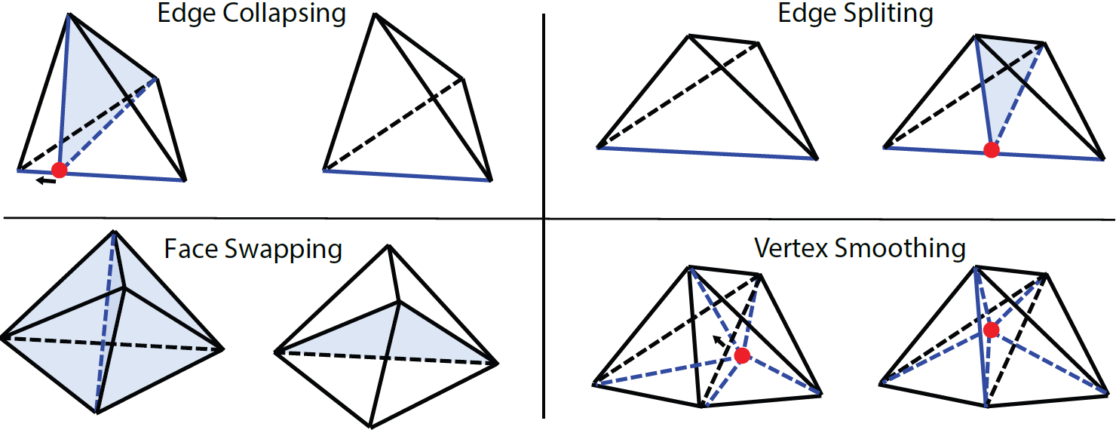
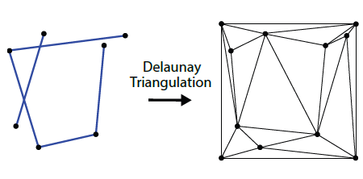
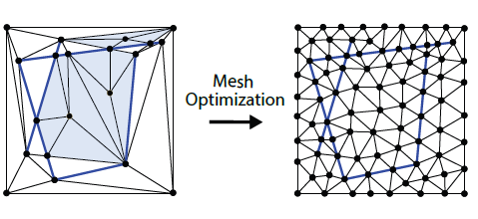
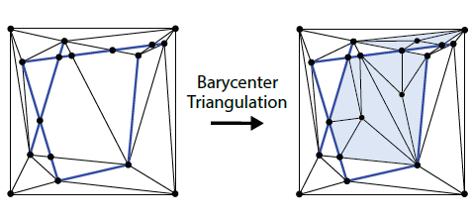
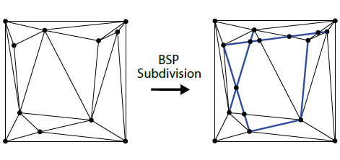
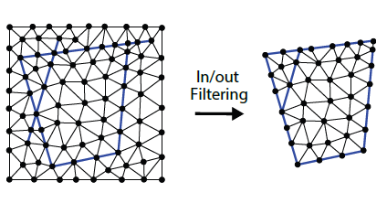
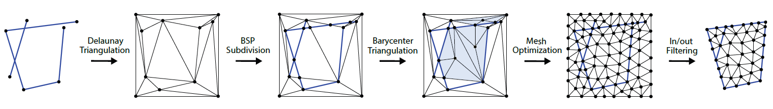
TetWild: Pipeline in 2D
Phase 1
Phase 2
Notes:
Bunch of ssegments as inputs.
Everythin in exact rationals.
CGAL represents numbers in fractions.
The numerator and denominator could be large integers.
1. Delaunay triangulation. Input is put inside a box slighty larger than the input. Partitions the box into convex cells.
> DT or DTET is known to be robust. But, does not conform to input boundary.
2. BSP Subdivision. For preserving the input boundary, and resolving self-intersections. First a BSP tree using the triangles we got in the first step as the initial tree nodes. The line of the input-segment to subdivide the bsp cells. Out: a polygonal mesh.
3. Triangulate the mesh. Since all BSP cells are convex, the easist way to add vertices in the centroid of the polygonal cells then connect it to the edges to form triangles. With this step the first stage is finished. Out: valid triangle mesh in rationals.
Valid: no inversion or self-intersections. Input boundary is preserved.
But: mesh could be in low quality. Output contains no inversions in exact rationals but if converted to floating point, might contains inversions.
4. To improve its quality we need mesh optimization. AS the quality improves we could gradually we can convert to floating points. They use four local operations for opt:
- edge splitting
- edge collapsing
- face swapping
- vertex smoothing
Details in report.
Edge collapse: one vertex to another. To accept the operations: check if the quality is improved. The quality measure they use is conformal amips 3d energy. If the local energy increase the local quality decrease: reject operation.
This could introduce inversions in the mesh. Need inversion check.
Envelope check for making sure that the vertex does not exceed the boundary.
If all checks pass, the operation is accepted.
5. In/out filtering: Remove all element outside the boundary. They use generalized winding number (Jacobson. ps test of time award at this siggraph). Compute winding number for centroid of each cell. If winding number is larger than 0.5, then it means they are outside and they delete them.
Pipeline is finished and we get a valid high quality mesh in floating points.

Slide 13
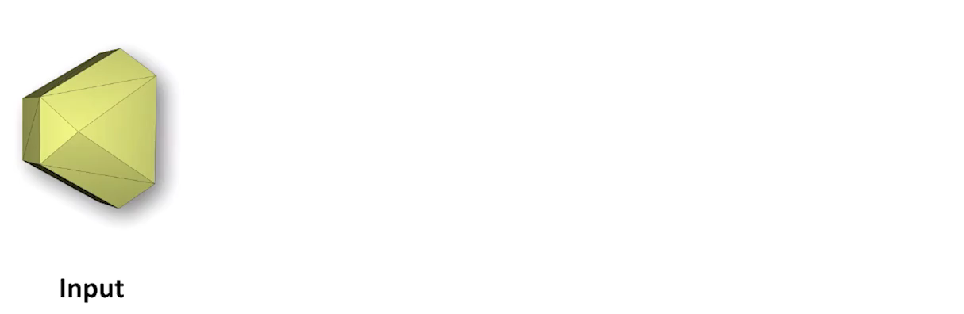
TetWild: Pipeline in 3D
TetWild Hu et al. 2018, SIGGRAPH 2018

Slide 14
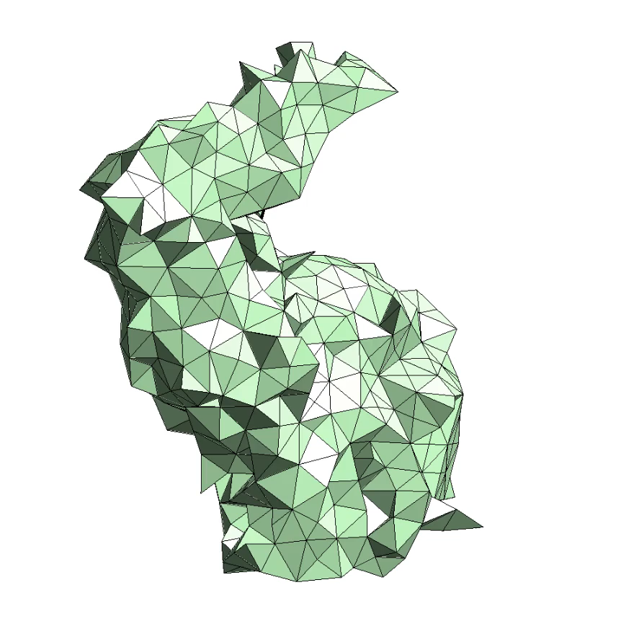
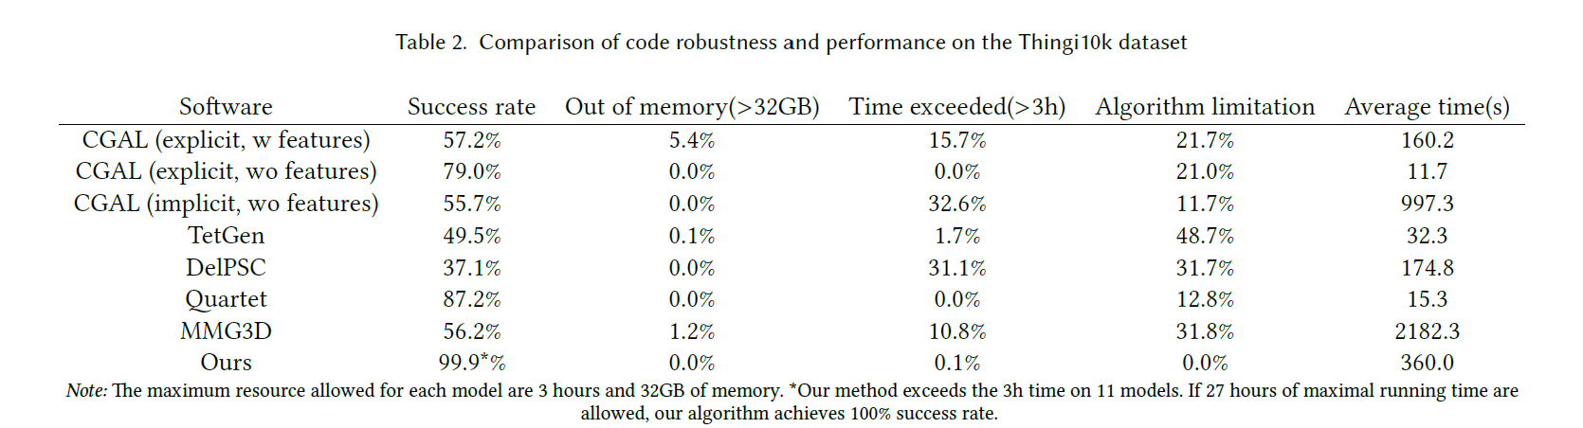
TetWild: Advantages
2 Parameters
Ideal Edge Length (l)
Envelope Size ()
Default l,
High : 0.001
Notes:
Easy to use. Needs two parameter:
1. ideal edge length: diag_of_bbox / 20
2. Envelope size. Smaller: better feauture preservation.
99.9 percent success rate when limited to 3 > hr and < 32 gb mem. 100 % if 27 hrs and < 1oo gb.
They have very interesting comparisons and visualization, so check them out if you are interested. Especially seeing the noise stress is quite impressive.
Method can be used for:
- surface repair
- cad models
- Structured meshing: quadmeshes,
- hexidral mesh or hex-dominant meshes
- when dealing with input boundary, the method allows smoothing to handle open regions
- meshing for multi materials solids
- multi component input
- works also well with thin surfaces

Slide 15
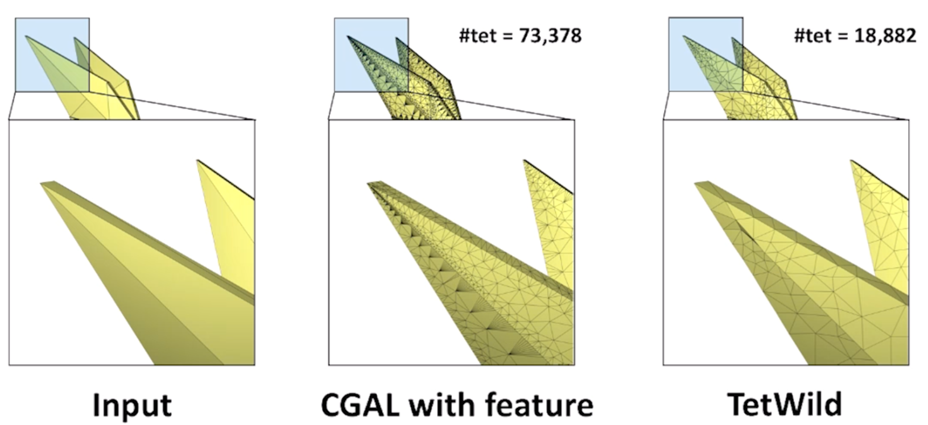
TetWild: Limitations
Sharp features handled softly.
Balance between robustness vs. faithfulness.
Surface repairing only limited to suface without large openings.
Original TetWild (Hu et al. 2018) is slow due to exact rational and envelope checks.
But, check out Fast TetWild, Hu et al. 2020.
Notes:
Sharp features handled in a soft way.
Balance between feature preservation, robustness, and efficiency.
For example, tiny crease at the end of the ear is not preserved if the envelope size is not small enough.
For repairing method is limited to surface without large openings.
Rational based computation and envelope check is slow.
But fast TetWild address performance.

Slide 16
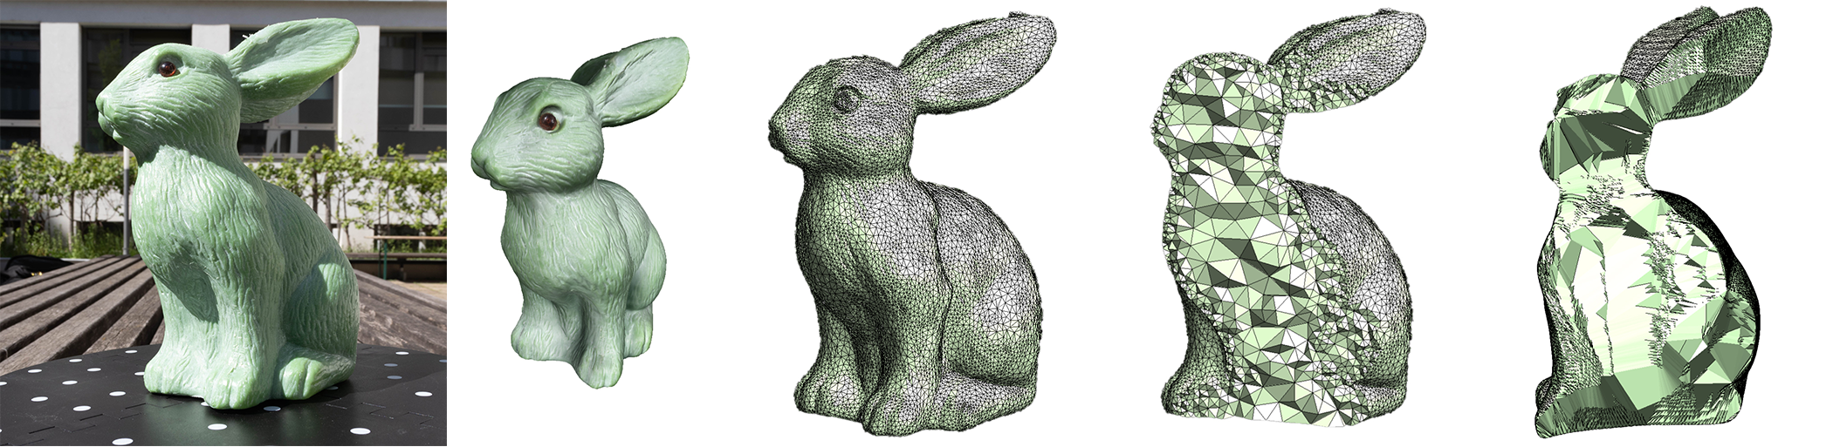

Thank You for your Attention!
(Constrained) Delaunay Triangulation in 2D
Approximately Constrained Tetrahedralization: TetWild Hu et al. 2018
Constrained Delaunay Tetrahedrization*, Diazzi et al. 2023
Check out our report
(TetWild, Hu et al. 2018)
(CDT, Diazzi et al. 2023)

Slide 17
Thank You for your Attention!
Don't forget to include a last slide that contains teaser images or a video or something else that reminds people about what you said.
It might well be that this slide will be on the screen during the whole discussion!

Slide 18
Headline
Level 0
Level 1
Level 2
Hint: Do NOT use bullet lists wherever possible !!!

Slide 20
Sometimes a dark background is better. Use this template.

